Slide 1
Full-Stack MERN Application
E-COMMerce website
Ilef dimassi
Gomaycode-sousse

Slide 2
General Presentation :
MERN stands for MongoDB, Express, React, Node, after the four key technologies that make up the stack.
MongoDB — document database
Express(.js) — Node.js web framework
React(.js) — a client-side JavaScript framework
Node(.js) — the premier JavaScript web server

Slide 3
Presentation:
Using React , Node.js , Express & MongoDB i build a Full stack MERN projet .
The app is called « e-commerce » is one that allows people to buy and sell physical goods, services, and digital products over the internet rather than at a brick-and-mortar location. Through an e-commerce website, a business can process orders, accept payments, manage shipping and logistics, and provide customer service.

Slide 4
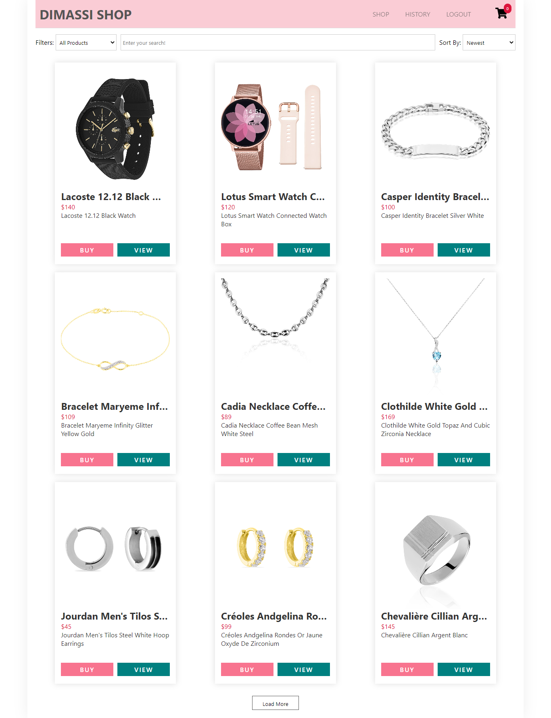

Slide 5
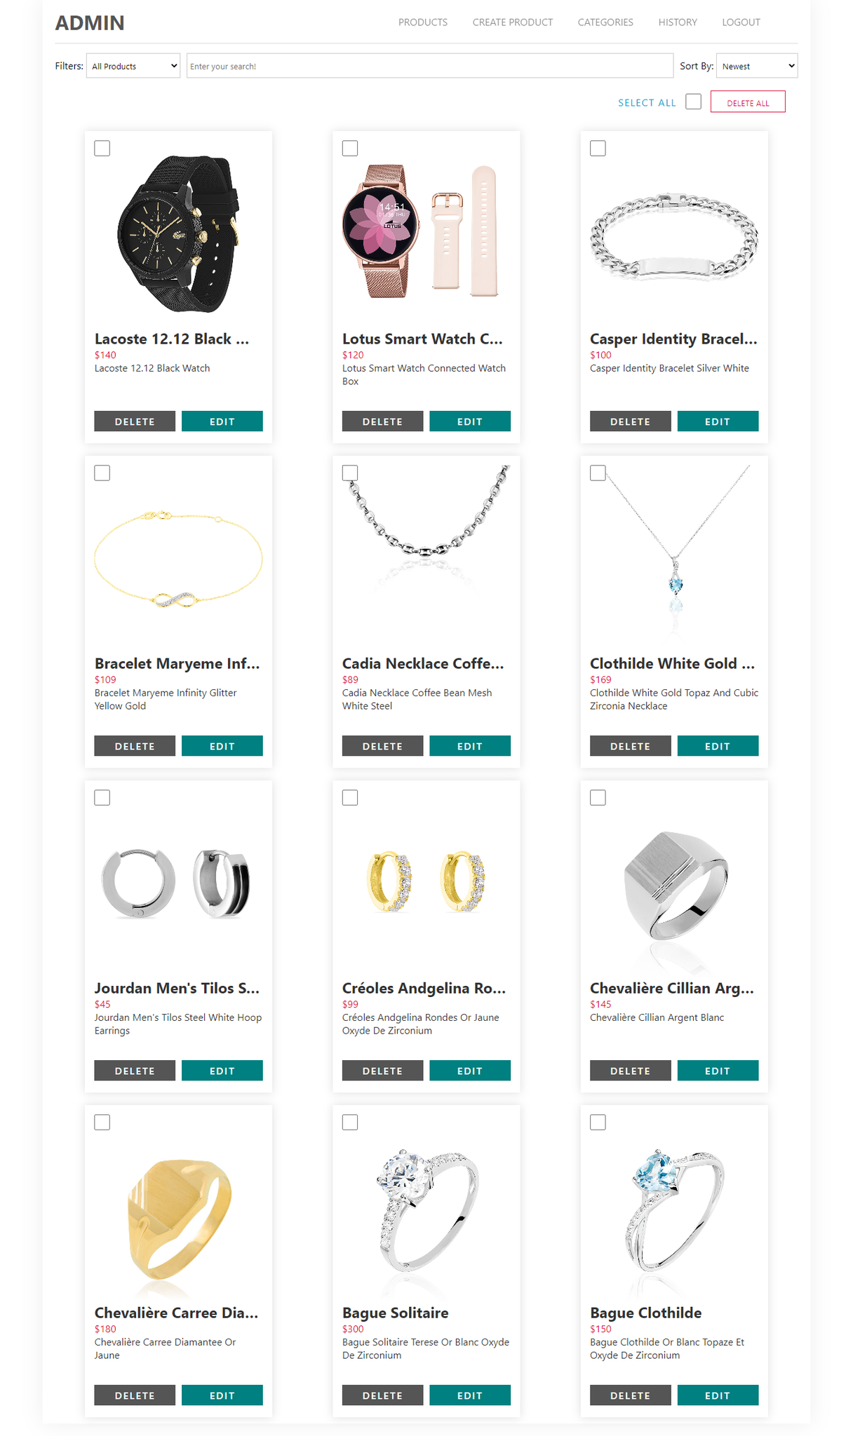

Slide 6
